Slide 1
Combinational Logic
Multiplexer (MUX)

Slide 2
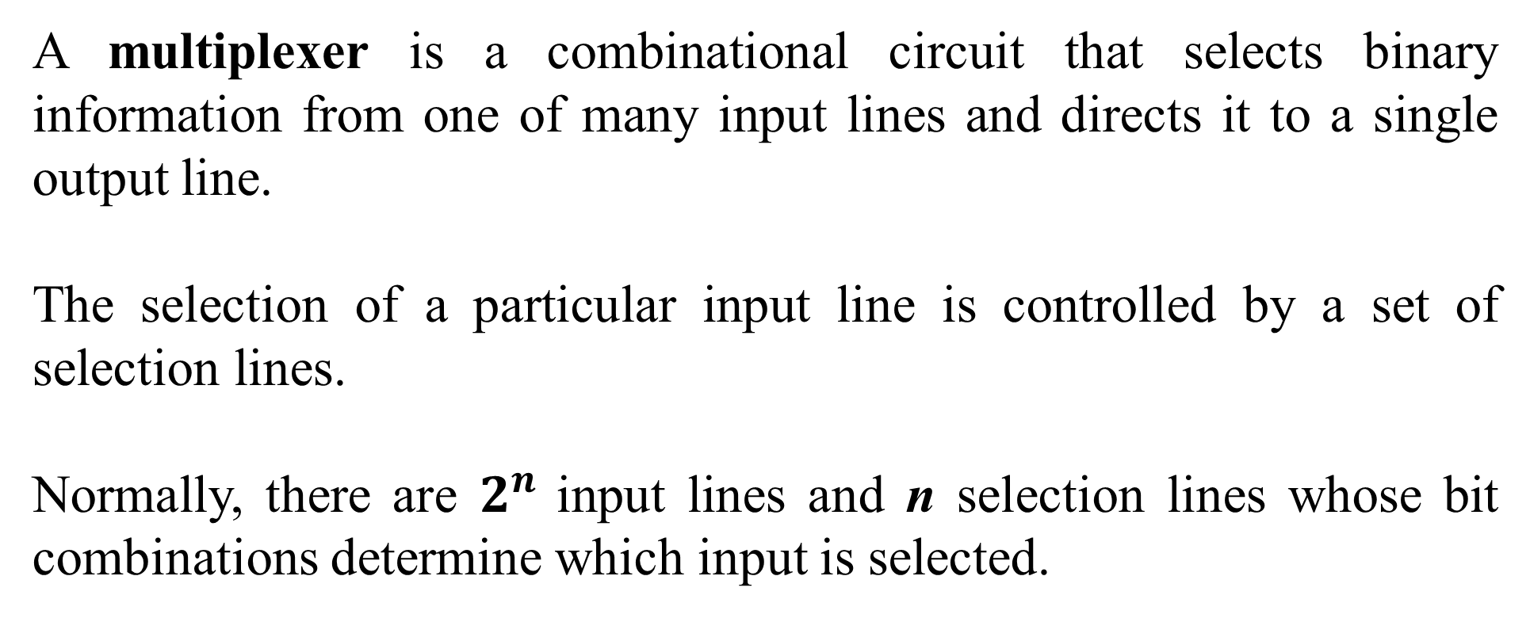
A multiplexer is a combinational circuit that selects binary information from one of many input lines and directs it to a single output line.
The selection of a particular input line is controlled by a set of selection lines.
Normally, there are $2^{n}$ input lines and n selection lines whose bit combinations determine which input is selected.

Slide 3
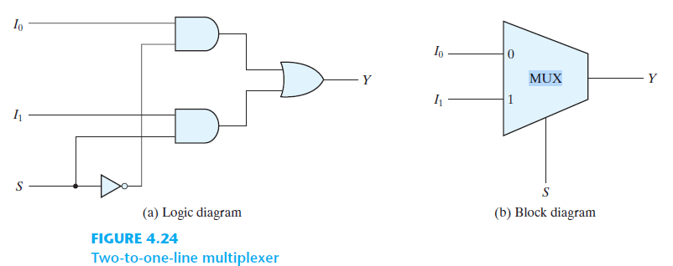
Two-to-one-line Multiplexer: A two-to-one-line multiplexer connects one of two 1-bit sources to a common destination, as shown in Fig. 4.24 . The circuit has two data input lines, one output line, and one selection line S . When S = 0, the upper AND gate is enabled and I0 has a path to the output. When S = 1, the lower AND gate is enabled and I1 has a path to the output. The multiplexer acts like an electronic switch that selects one of two sources. The block diagram of a multiplexer is as shown in Fig. 4.24(b) . The multiplexer is often labeled “MUX” in block diagrams.
Reference: Digital Design, 5th edition by Morris Mano and Michael Ciletti

Slide 4
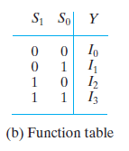
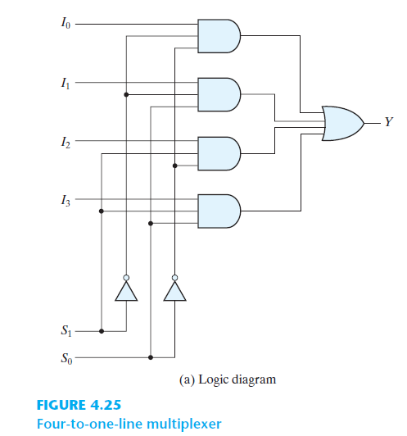
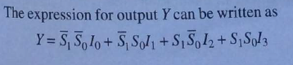
4:1 Multiplexer using Gates
Reference: Digital Electronics by G. K. Kharate

Slide 5
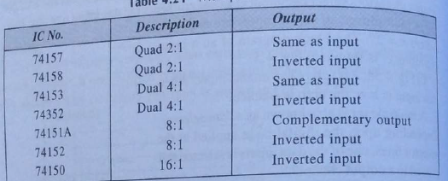
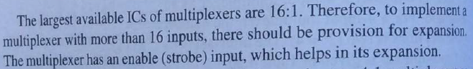
The 4:1, 8:1 and 16:1 are available in following ICs
Reference: Digital Electronics by G. K. Kharate

Slide 6
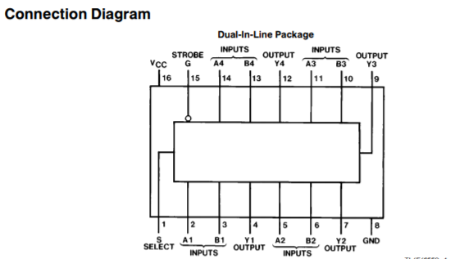
74157 MUX IC

Slide 7
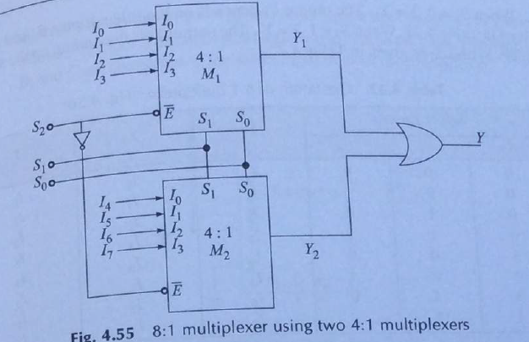
8:1 Multiplexer using two 4:1 MUX ( Multiplexer Tree/Multiplexer Cascading)
Reference: Digital Electronics by G. K. Kharate

Slide 8
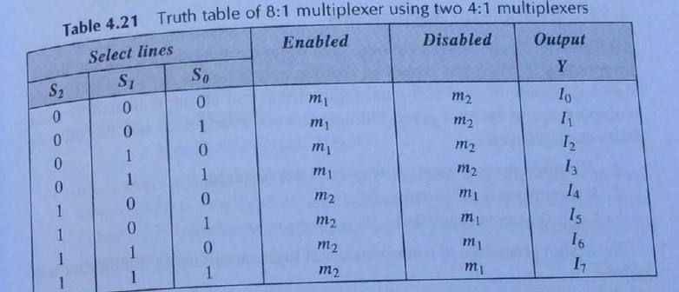
Reference: Digital Electronics by G. K. Kharate

Slide 9
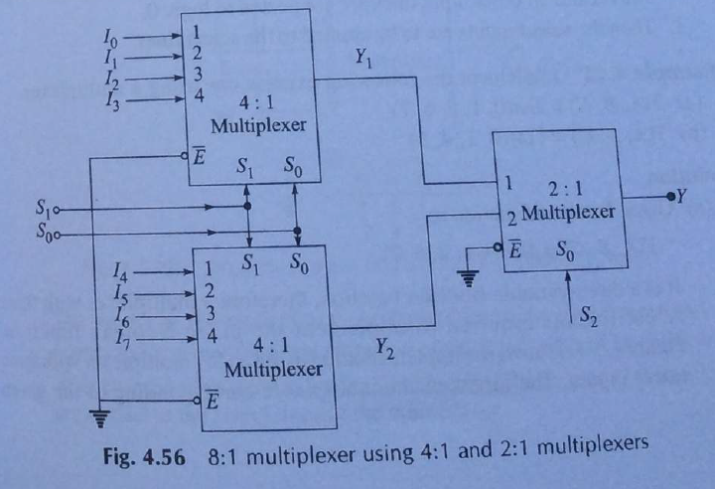
Multiplexer Cascading 8:1 multiplexer using 4:1 and 2:1 multiplexers
Reference: Digital Electronics by G. K. Kharate

Slide 10
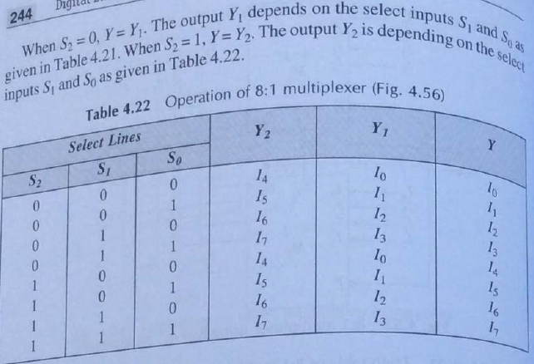
Reference: Digital Electronics by G. K. Kharate

Slide 11
Multiplexer Applications: 1.Simplification of logic expression is not required. 2.It minimizes the IC count. 3. Logic design is simplifies. Applications Ares of Multiplexer: Multiplexer are used in various fields where multiple data need to be transmitted using a single line. Following are some of the applications of multiplexers – 1. Communication system – Communication system is a set of system that enable communication like transmission system, relay and tributary station, and communication network. The efficiency of communication system can be increased considerably using multiplexer. Multiplexer allow the process of transmitting different type of data such as audio, video at the same time using a single transmission line. 2. Telephone network – In telephone network, multiple audio signals are integrated on a single line for transmission with the help of multiplexers. In this way, multiple audio signals can be isolated and eventually, the desire audio signals reach the intended recipients. 3. Computer memory - Multiplexers are used to implement huge amount of memory into the computer, at the same time reduces the number of copper lines required to connect the memory to other parts of the computer circuit. 4. Transmission from the computer system of a satellite – Multiplexer can be used for the transmission of data signals from the computer system of a satellite or spacecraft to the ground system using the GPS (Global Positioning System) satellites.

Slide 12
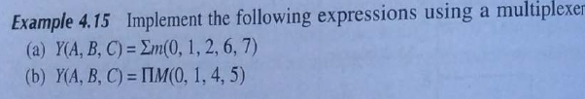
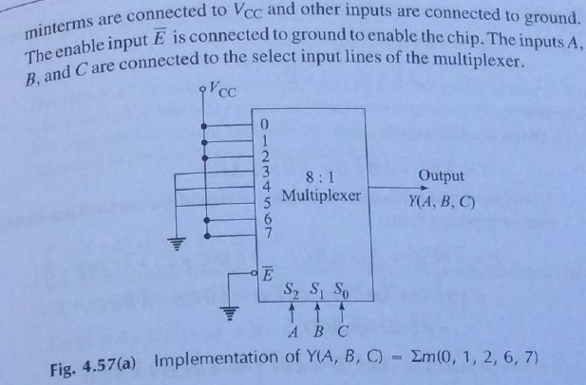
Reference: Digital Electronics by G. K. Kharate

Slide 13
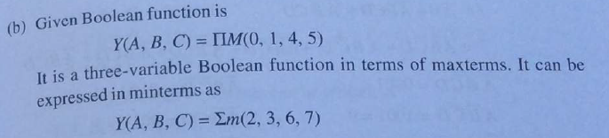
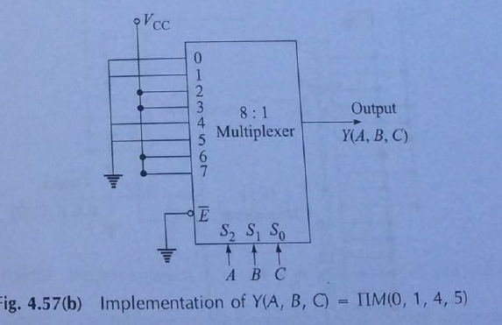
Reference: Digital Electronics by G. K. Kharate

Slide 14
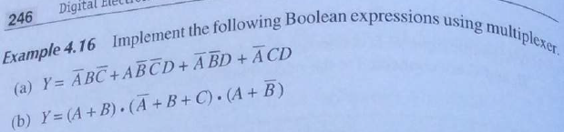

Slide 15
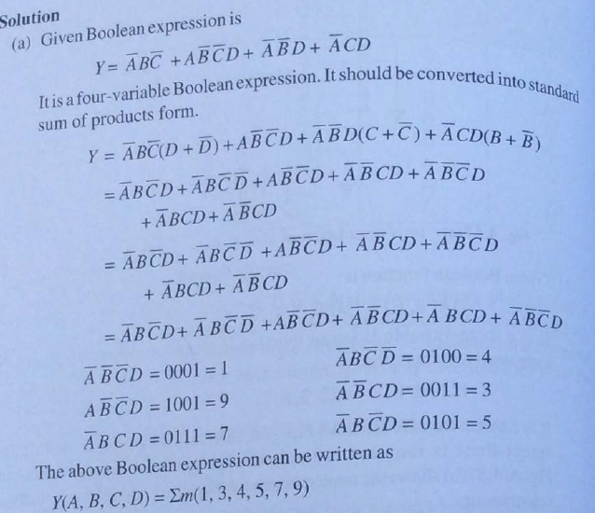
Reference: Digital Electronics by G. K. Kharate

Slide 16
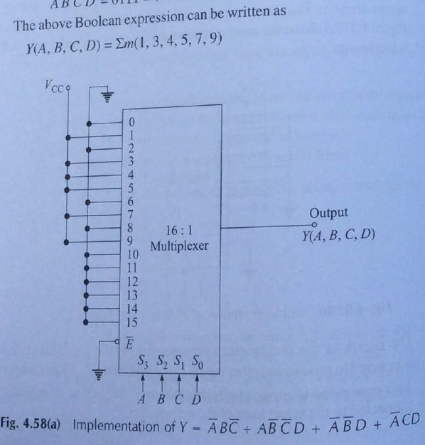
Reference: Digital Electronics by G. K. Kharate

Slide 17
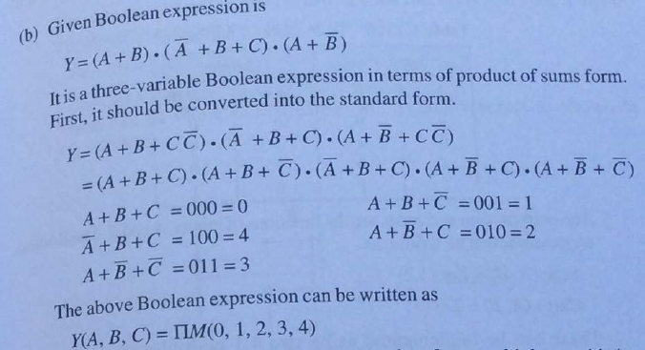
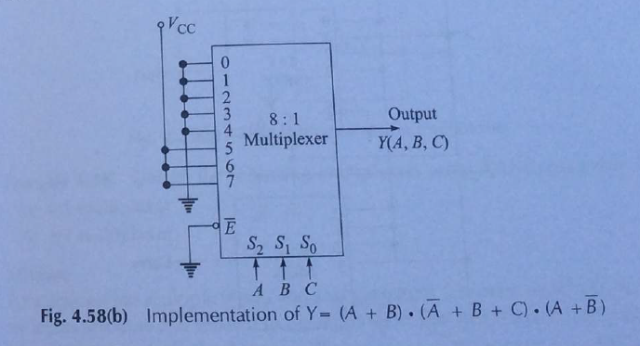
Reference: Digital Electronics by G. K. Kharate

Slide 18
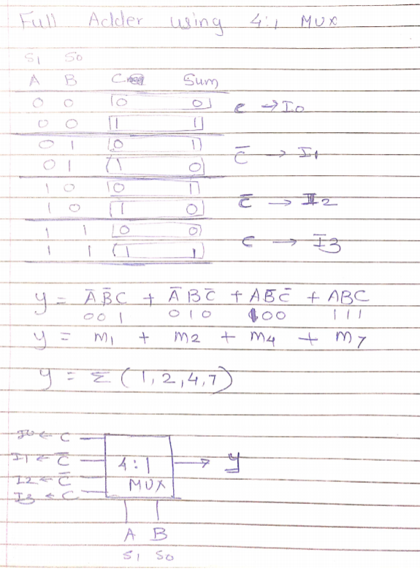
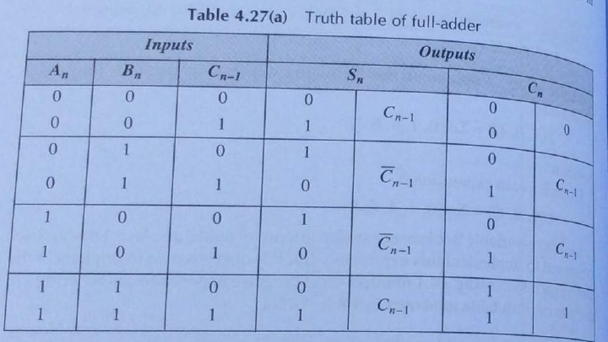
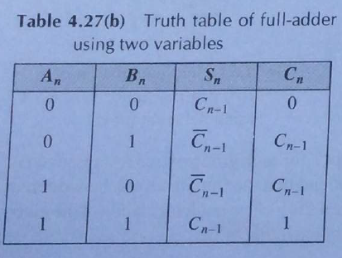
Implement Full Adder using 4:1 MUX

Slide 19
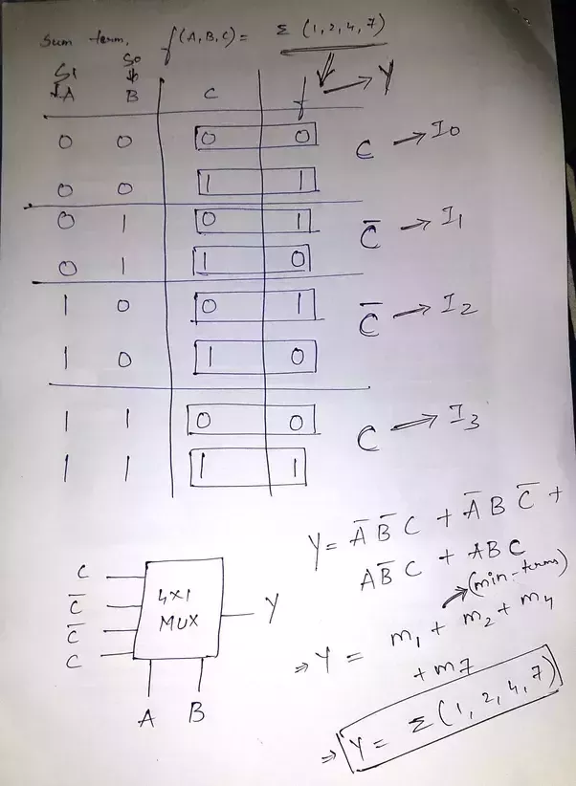
For Sum

Slide 20
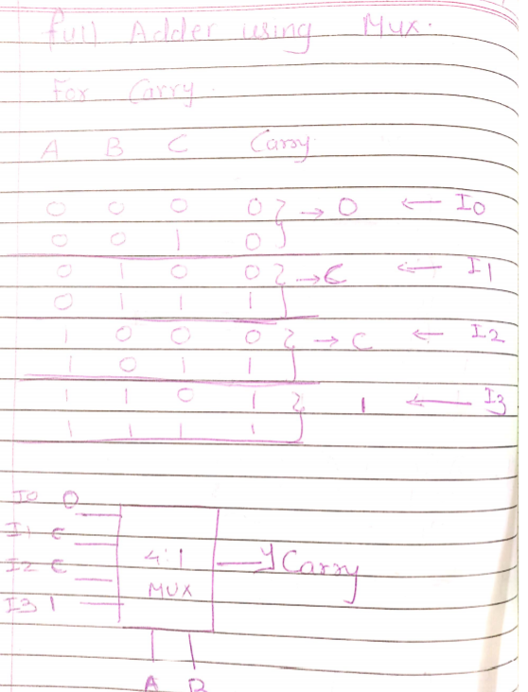
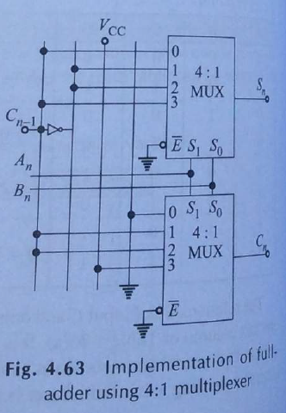
For Carry
Reference: Digital Electronics by G. K. Kharate

Slide 21
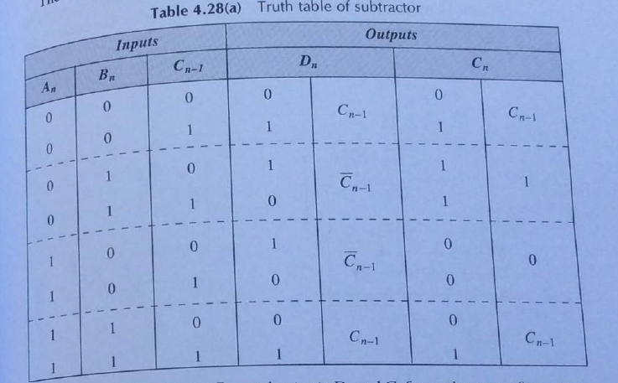
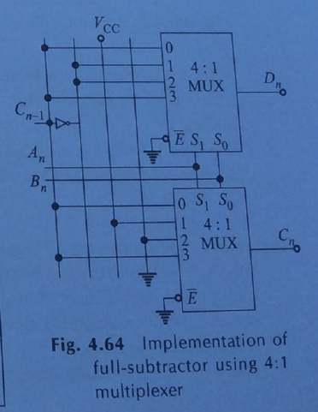
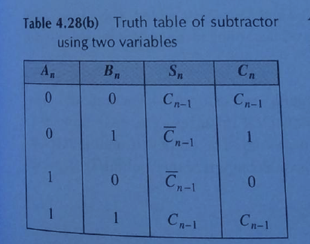
Implement Full Subtractor using 4:1 MUX
Reference: Digital Electronics by G. K. Kharate

Slide 22
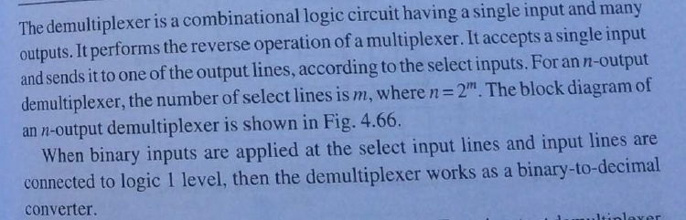
Demultiplexer:
Reference: Digital Electronics by G. K. Kharate

Slide 23
Applications of Demultiplexer:
1.Demultiplexer is used to connect a single source to multiple destinations. The main application area of demultiplexer is communication system where multiplexer are used. Most of the communication system are bidirectional i.e. they function in both ways (transmitting and receiving signals). Hence, for most of the applications, the multiplexer and demultiplexer work in sync. Demultiplexer are also used for reconstruction of parallel data and ALU circuits.
2. Communication System - Communication system use multiplexer to carry multiple data like audio, video and other form of data using a single line for transmission. This process make the transmission easier. The demultiplexer receive the output signals of the multiplexer and converts them back to the original form of the data at the receiving end. The multiplexer and demultiplexer work together to carry out the process of transmission and reception of data in communication system.
3. ALU (Arithmetic Logic Unit) – In an ALU circuit, the output of ALU can be stored in multiple registers or storage units with the help of demultiplexer. The output of ALU is fed as the data input to the demultiplexer. Each output of demultiplexer is connected to multiple register which can be stored in the registers.
4. Serial to parallel converter - A serial to parallel converter is used for reconstructing parallel data from incoming serial data stream.

Slide 24
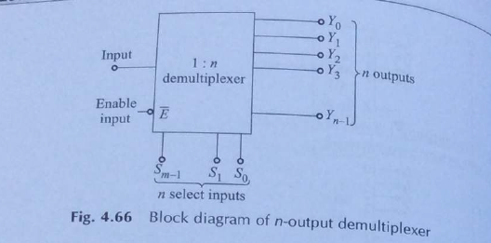
Block Diagram of 1:n Demultiplexer
Reference: Digital Electronics by G. K. Kharate

Slide 25
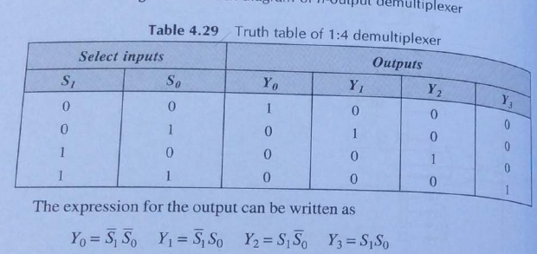
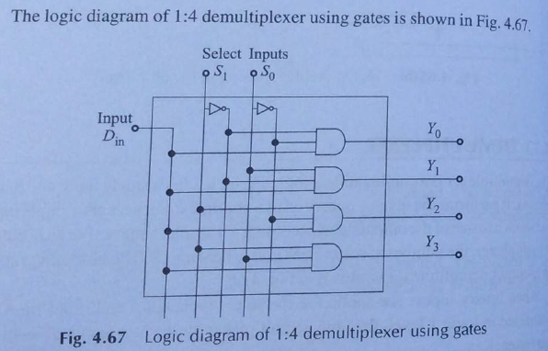
1:4 demultiplexer using gates

Slide 26
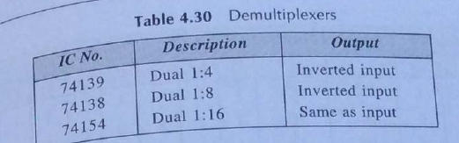
Demultiplexer ICs

Slide 27
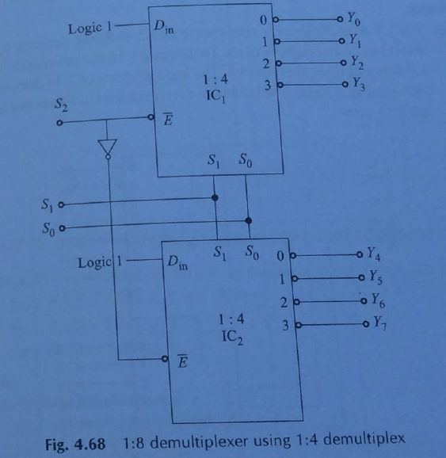
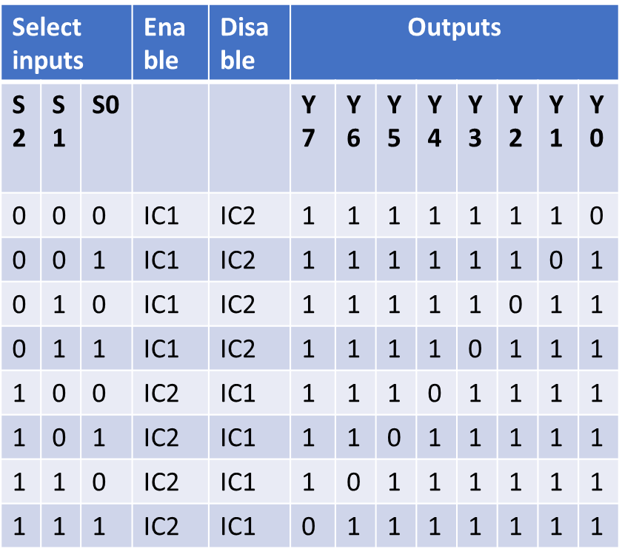
1:8 demultiplexer using 1:4 demultiplexer

Slide 28
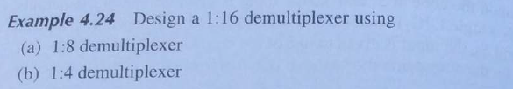
Cascading of Demultiplexer
Reference: Digital Electronics by G. K. Kharate

Slide 29
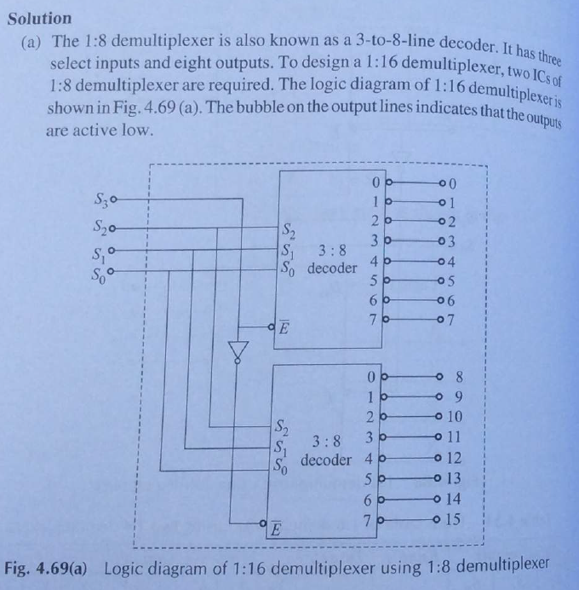
Reference: Digital Electronics by G. K. Kharate

Slide 30
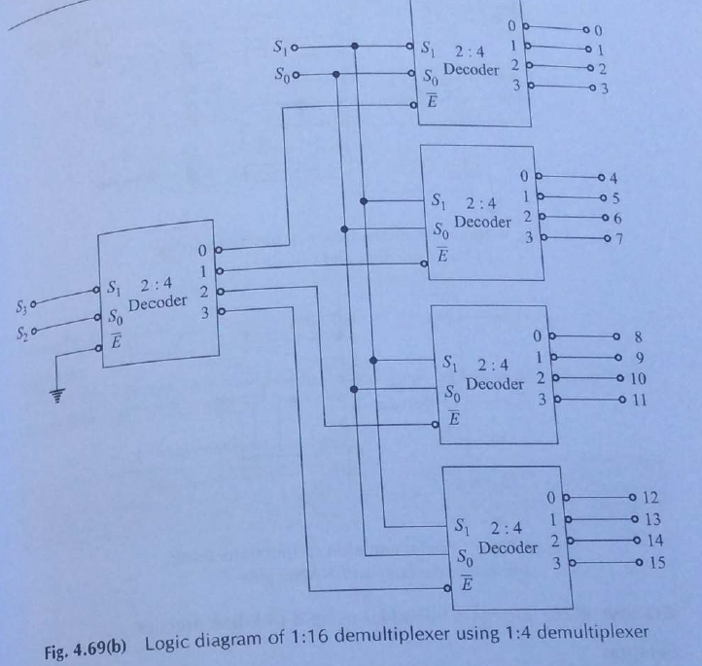
1:16 demultiplexer using 1:4 demultiplexer
Reference: Digital Electronics by G. K. Kharate

Slide 31
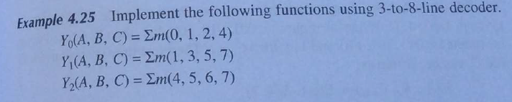
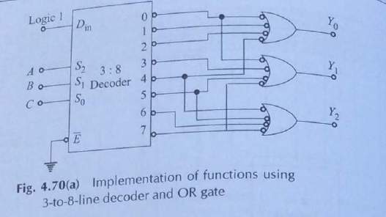
Using OR gate
Reference: Digital Electronics by G. K. Kharate

Slide 32
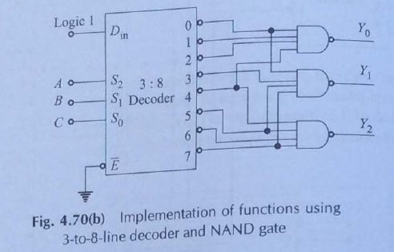
Using NAND Gate
Reference: Digital Electronics by G. K. Kharate

